Slide 1

COVID Analysis
Team Project Mafia

Slide 2






Meet the Team
Dhruv Shrivastava
Diego Victor Carlos Chavez
Padmapriya Panneerselvam
Gagan Pahuja
Zainab Aljaroudi
Ryan Egbert

Slide 3
Agenda
Problem Statement
Hypotheses
Analytical Approach
Project Execution & Approach
Sentiment Analysis
Number of Reviews Analysis
Regression Analysis
Recommendations
Next Steps
Project Learnings

Slide 4
Problem Statement
Airbnb is a crowd-sourced online marketplace for lodging, homestays and vacation rentals
When the COVID virus spread over the world in March 2020, there was a reduction in bookings and Airbnb had to cost cut on multiple functions
Airbnb is faced with a situation where they have to operate in a new and changed world
Airbnb not only bounces back to the pre-covid demand but its bookings grow past it
Airbnb makes strategic decisions based on the new understanding
Airbnb is able to understand the new world and it’s driving factors better
Airbnb understands the change in the driving factors of the quality and quantity of stays

Slide 5
What are the possible factors that affect bookings? - Hypotheses
Factors that affect bookings
Internal features influence bookings
External features have an effect on booking
Features of the property influences the bookings
Features of the hosts has an effect on the bookings
Time of the year influences bookings
Pandemic influences the bookings
Price affects booking
Room type affects bookings
Super hosts influence bookings
Hosts having a profile pic has an impact on their bookings
Host response rate could influence bookings

Slide 6
Our Approach
Step 1
Step 4
Sentiment Analysis
Regression
Step 3
Step 5
Step 2
Summarizing Results
Comparison of Sentiment Analysis with Reviews Analysis
Review Activity Analysis

Slide 7

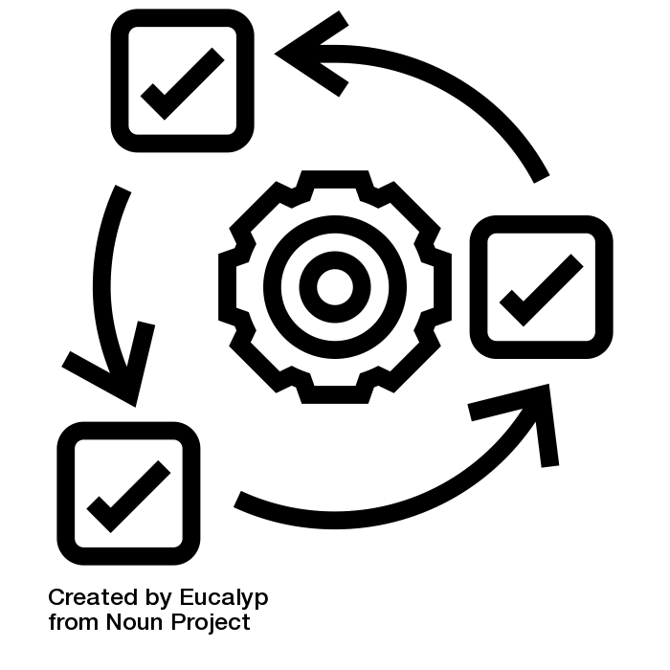
Project Execution & Approach
Waterfall Methodology
Tool Used: MS Project
Agile Methodology
Tool Used: Smartsheets

Slide 8
Waterfall Methodology
Define the tasks
Create Summary Tasks
Earned Value Analysis
Enter Task Duration Estimates
Define Precedence Relationship
Assign Resources
Lead/Lag Time between tasks
Create the GANTT chart
Create the PERT Diagram
Create Resources
Resource Levelling
Enter Actuals

Slide 9
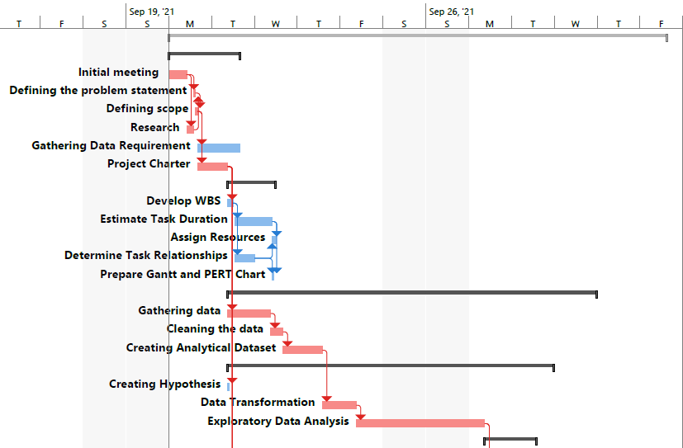
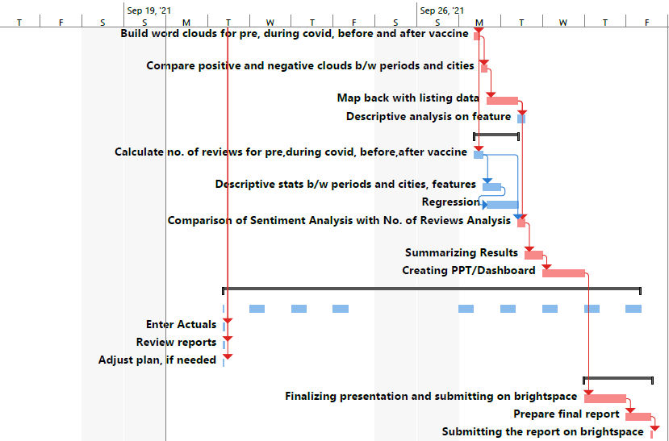
Gantt Chart

Slide 10
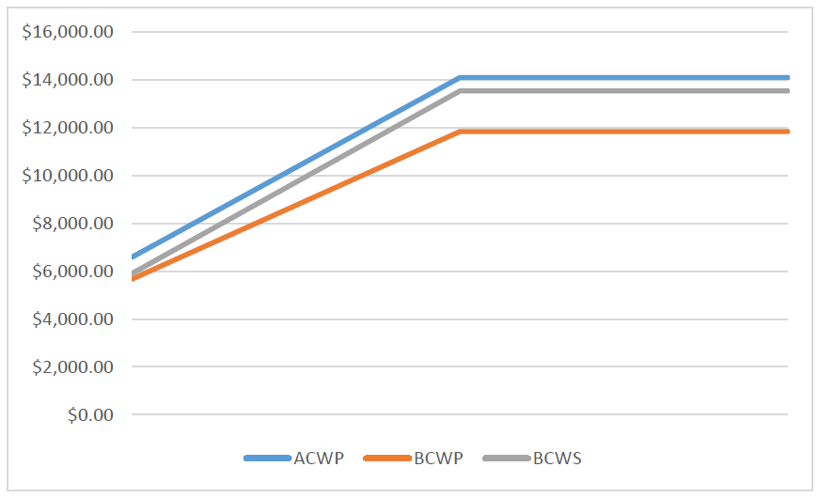
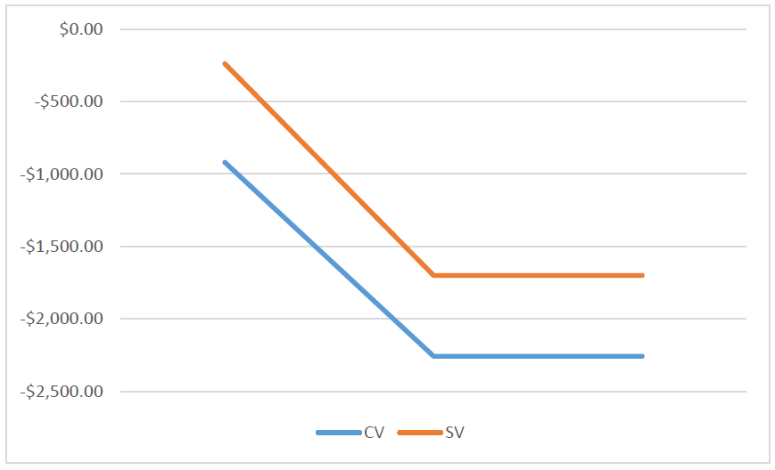
Earnd Value Analysis
EAC
ACWP
BCWP
$16,126.50
$14,102.50
$11,845.00

Slide 11
Agile Methodology
Creating User Stories
Kanban
MOSCOW Prioritization
Planning Poker
Story Points
Creating a backlog
Burn Down
Retrospective

Slide 12
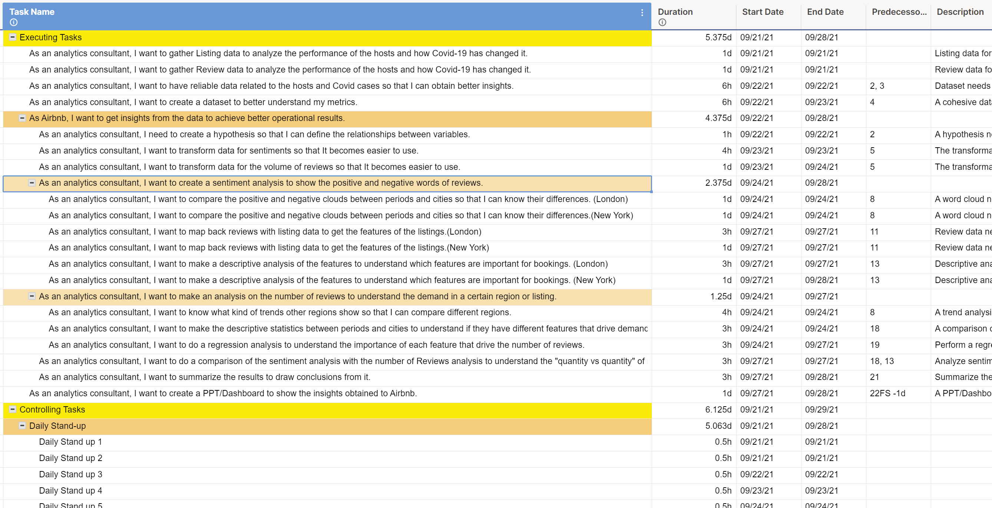
Agile Backlog

Slide 13
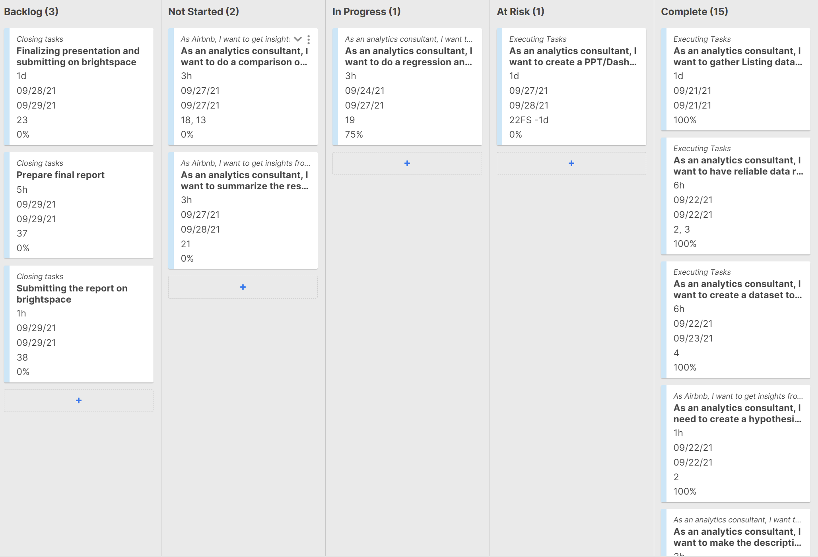
Kanban Board

Slide 14
Principles (Manifesto)
01
02
03
04
Face-to-Face Conversation
Self-Organizing Teams
Technical Excellence and Good Design
Reflection on how to Become More Effective

Slide 15

Covid Effect on Airbnb Activity

Slide 16
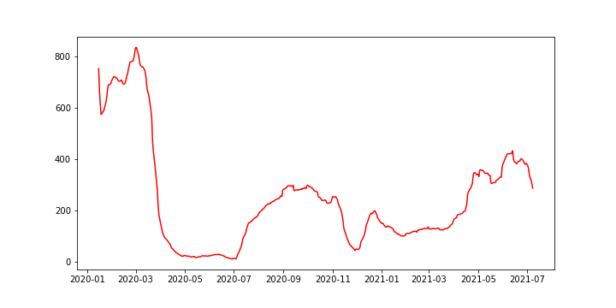
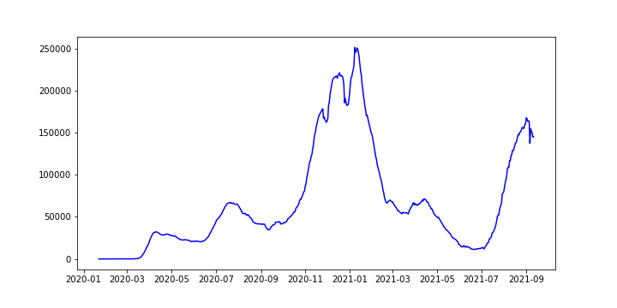
Covid Effects on Airbnb Activity – New York
Airbnb Activity
Covid Cases
Increase in vaccine distribution

Slide 17


Sentiment Analysis

Slide 18
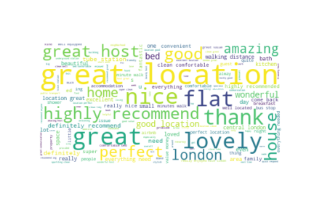
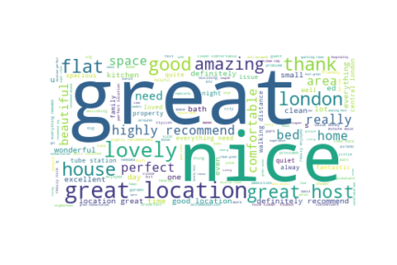
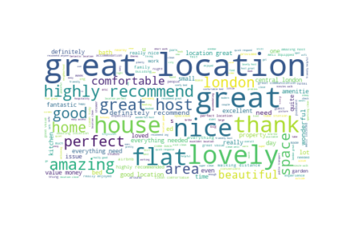
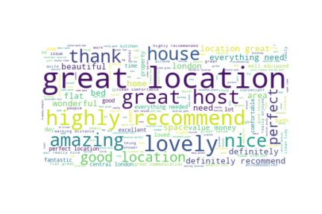
London Positive Sentiment
Pre-Covid
Covid
Pre-Vaccine
Post-Vaccine

Slide 19
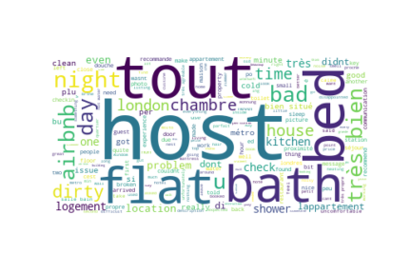
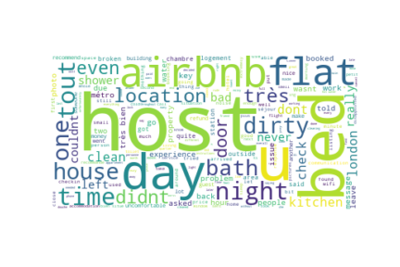
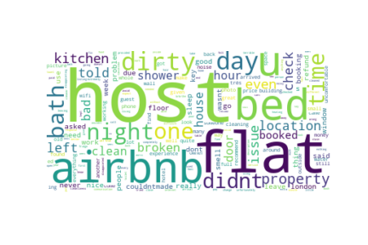
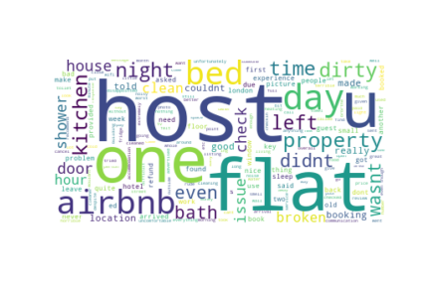
London Negative Sentiment
Pre-Covid
Covid

Slide 20
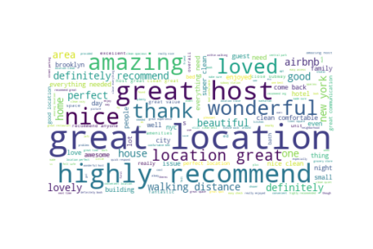
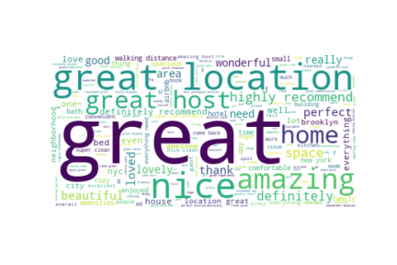
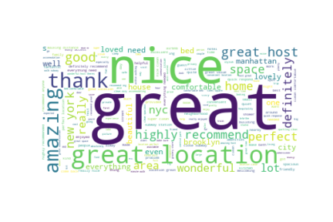

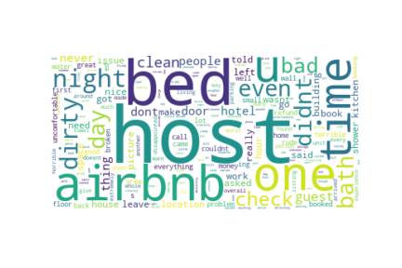
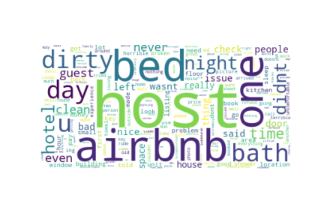
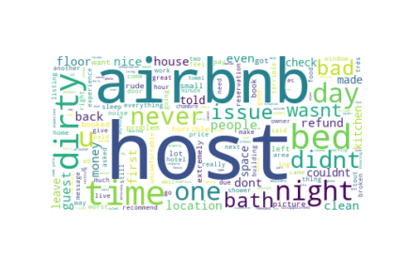
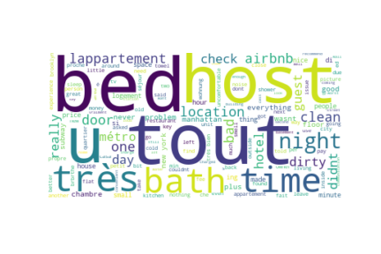
New York Sentiment

Slide 21

Sentiment Across Time

Slide 22
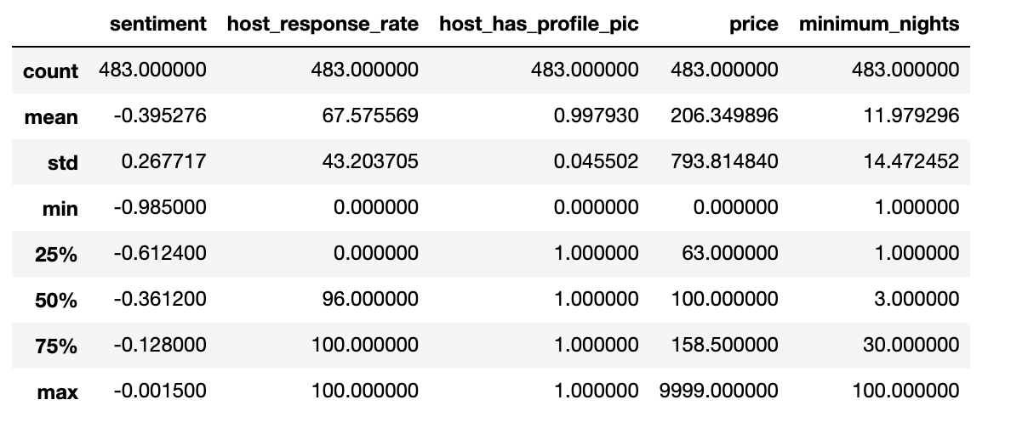
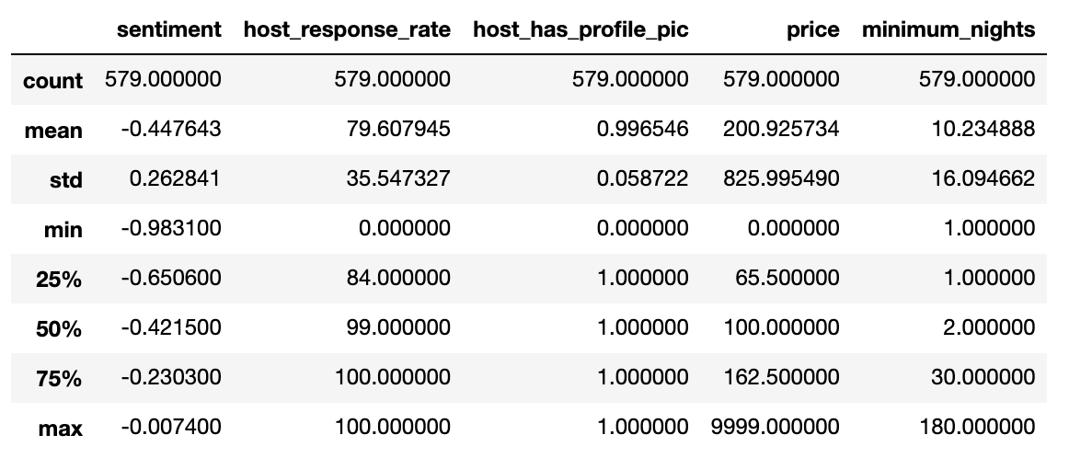
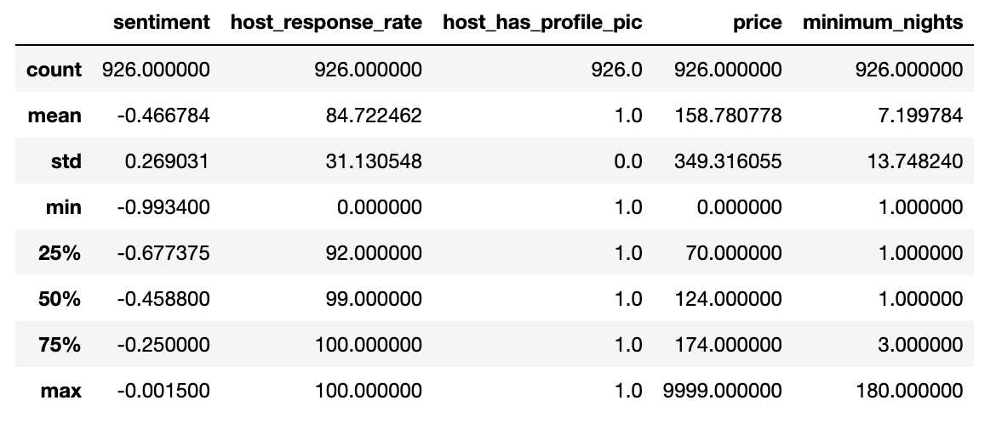
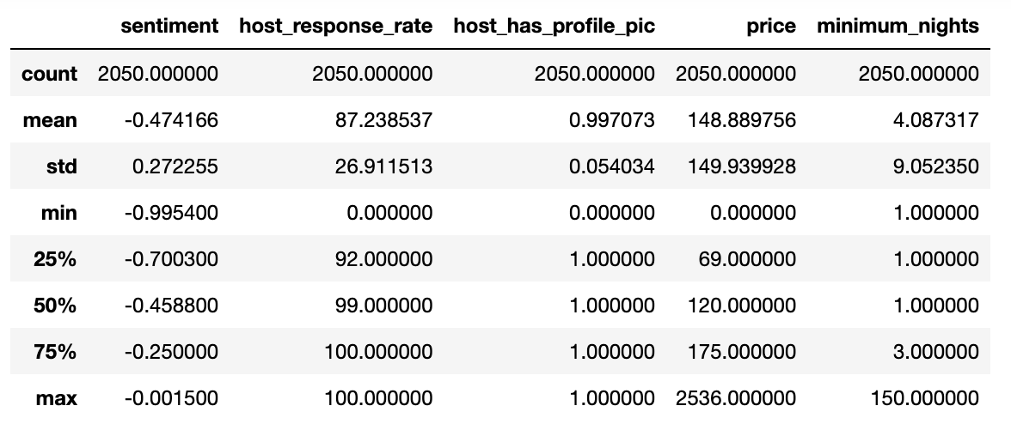
Negative Sentiment Features – New York
Pre-Covid
Covid
v
v
Pre-Vaccine
Post Vaccine
v
v

Slide 23
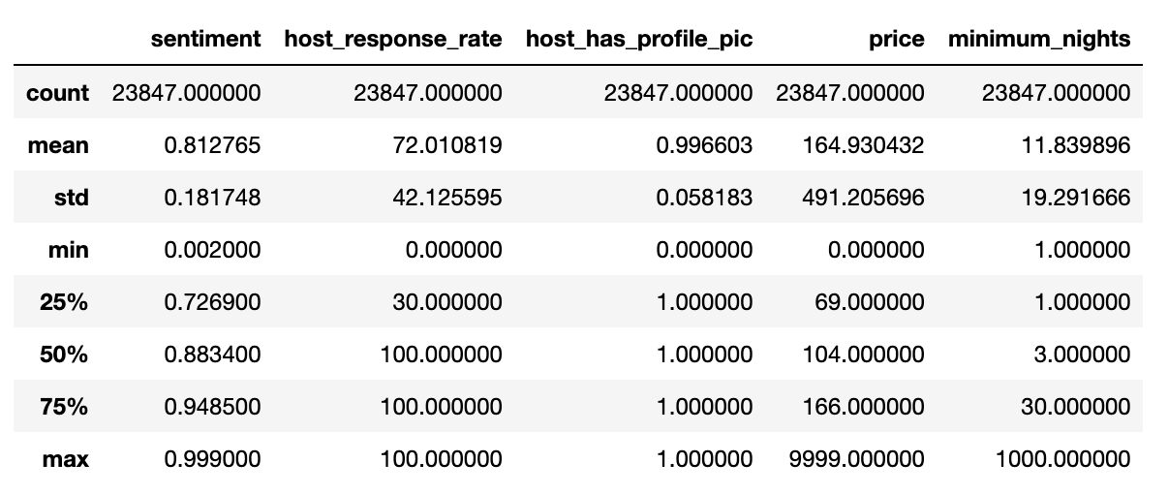
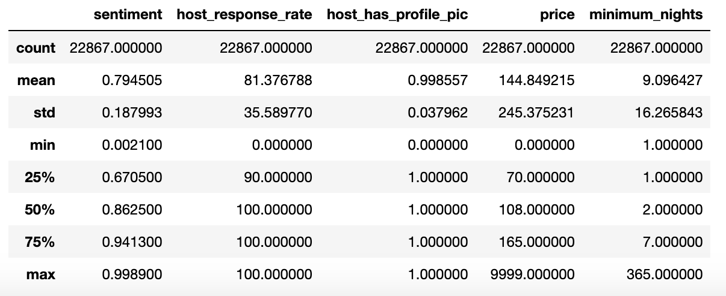
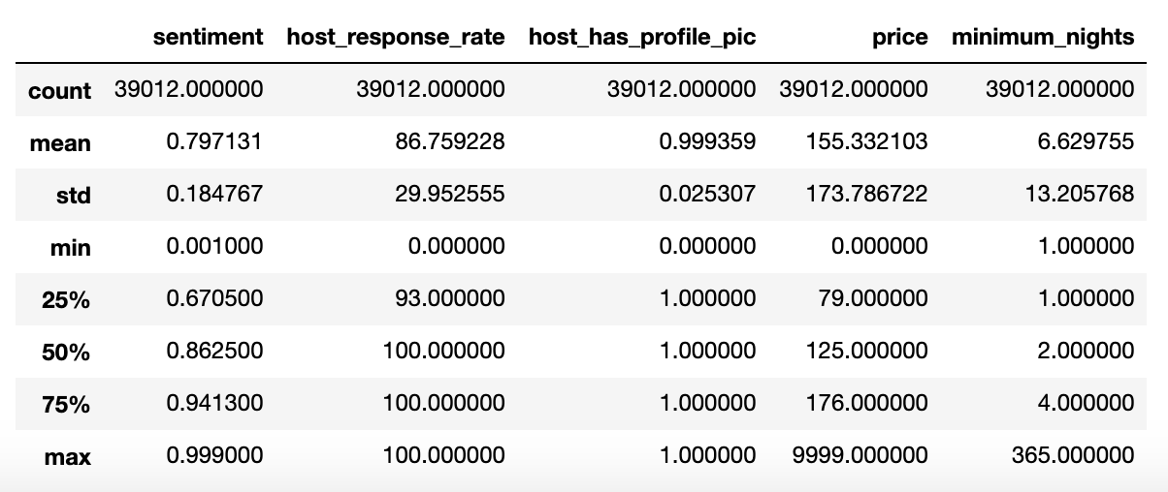
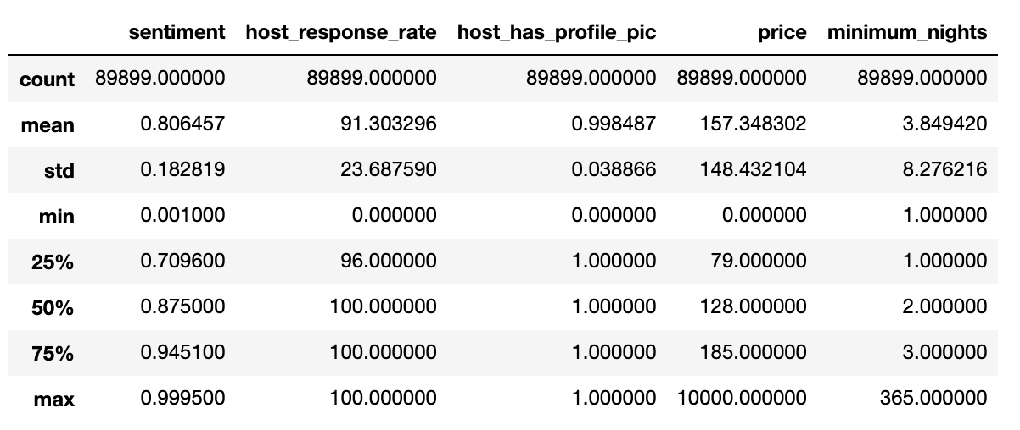
Positive Sentiment Features – New York
Pre-Covid
Covid
v
v
Pre-Vaccine
Post Vaccine
v
v

Slide 24
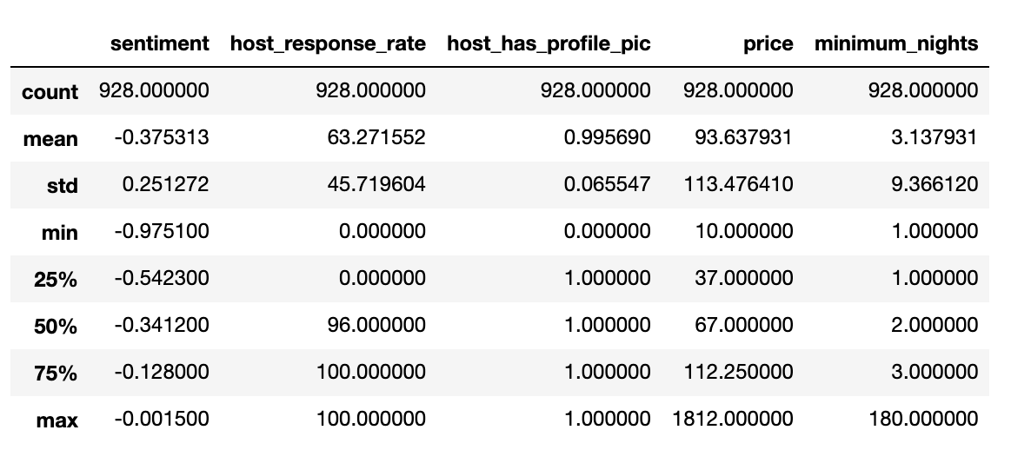
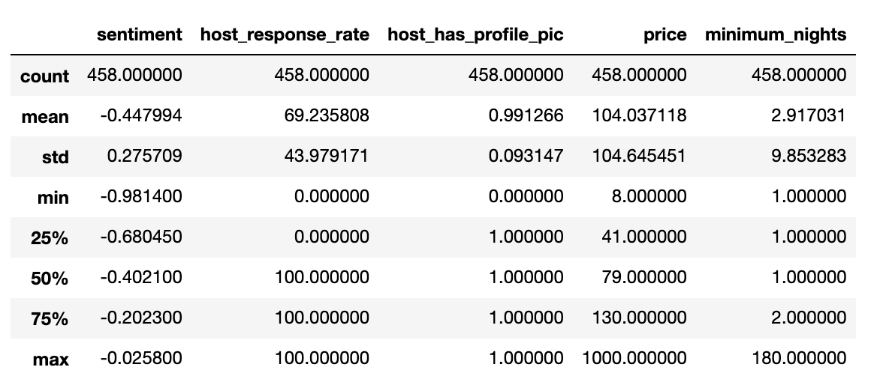
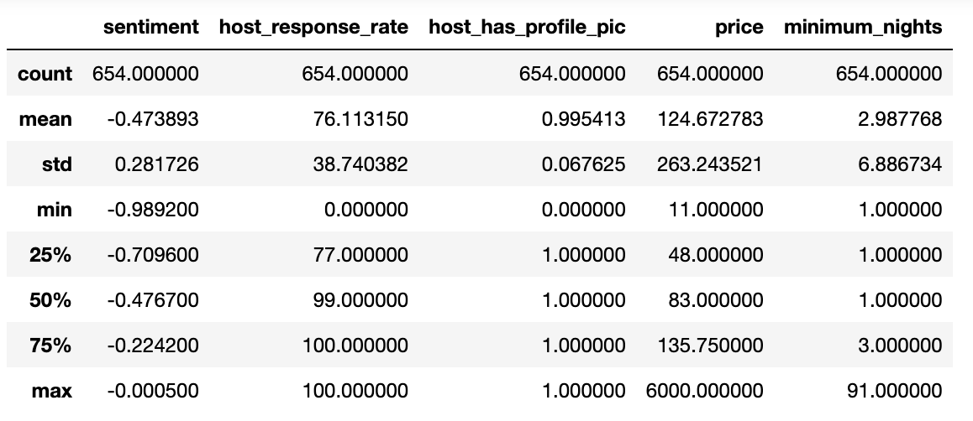
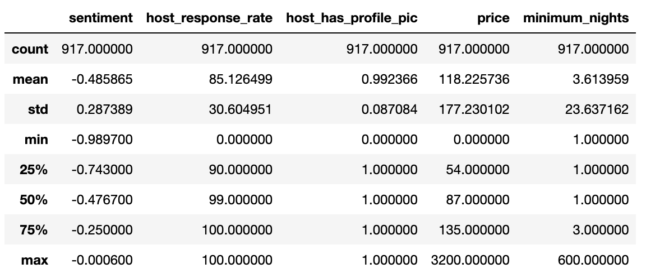
Negative Sentiment Features – London
Pre-Covid
Covid
v
v
Pre-Vaccine
Post Vaccine
v
v

Slide 25
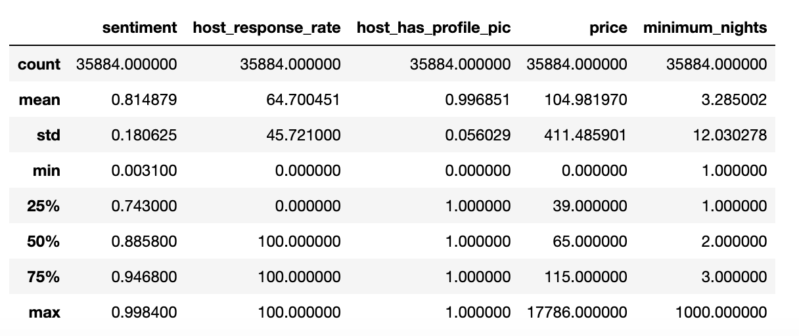
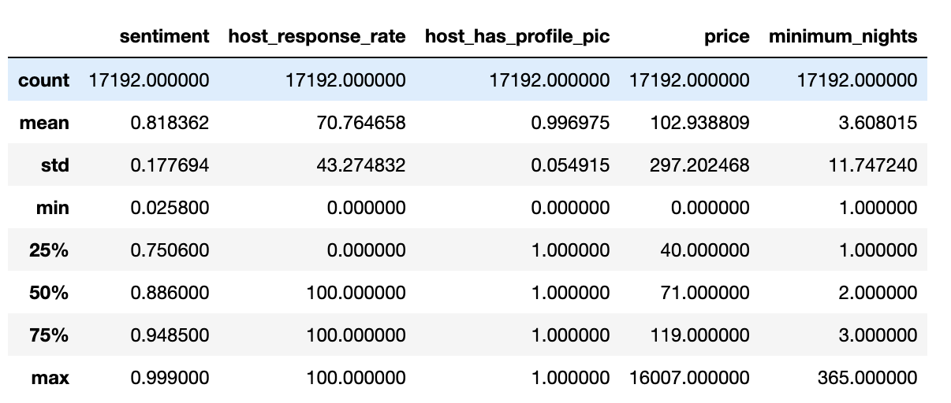
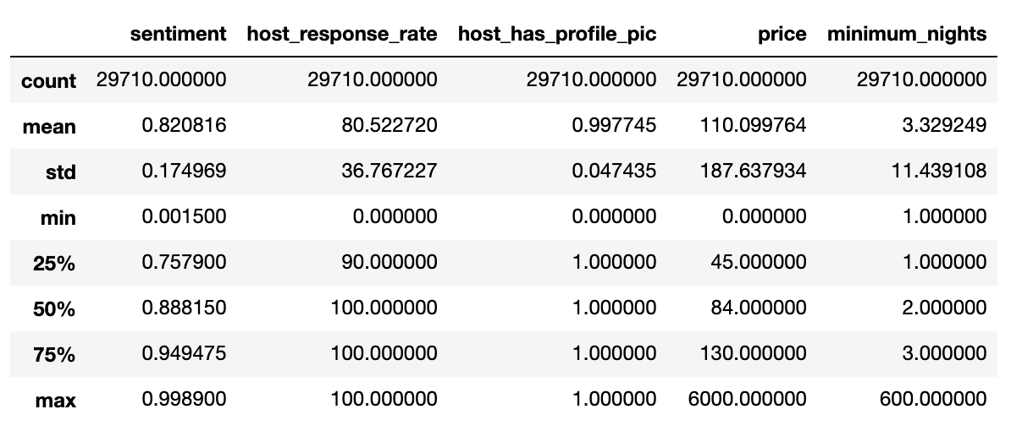
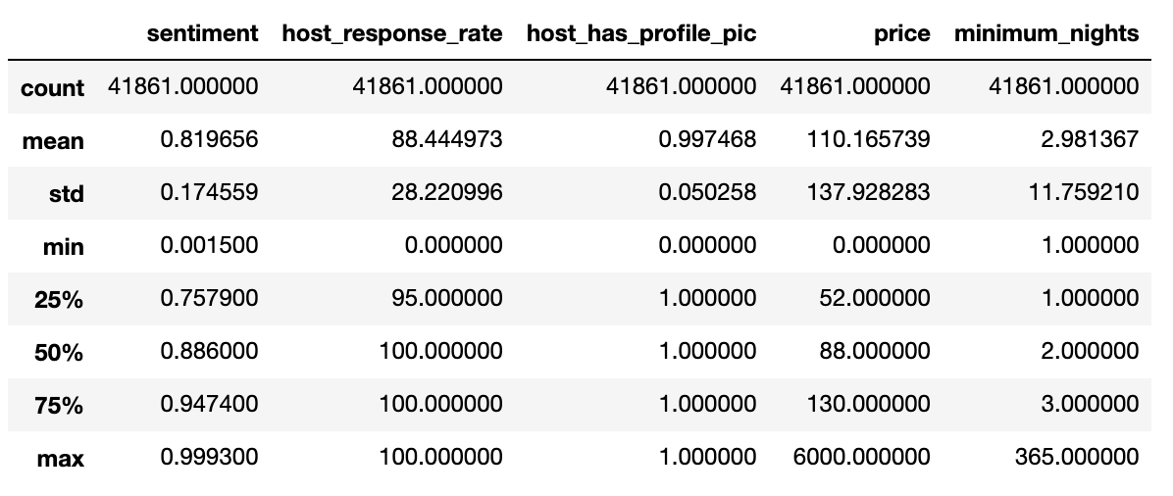
Positive Sentiment Features – London
Pre-Covid
Covid
v
v
Pre-Vaccine
Post Vaccine
v
v

Slide 26

New York Activity Analysis

Slide 27
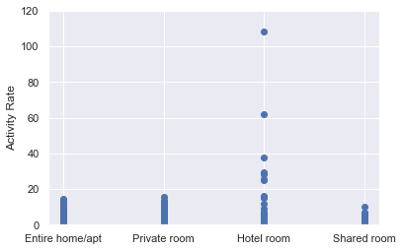
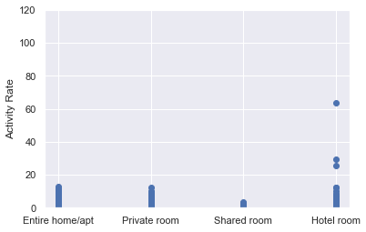
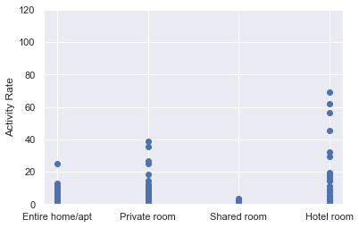
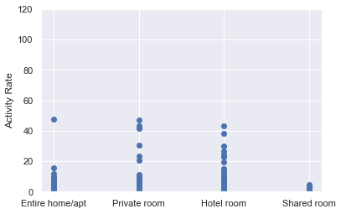
Activity vs Room Type
Pre-Covid
Covid
Pre-Vaccine
Post-Vaccine

Slide 28
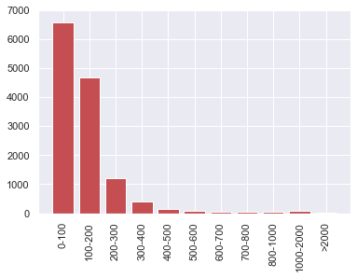
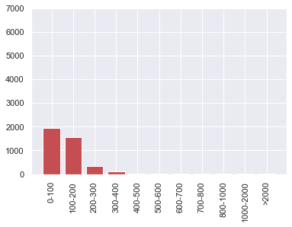
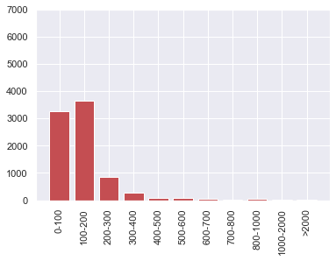
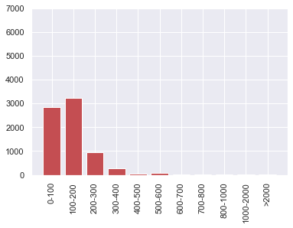
Activity vs Price
Pre-Covid
Covid
Pre-Vaccine
Post-Vaccine

Slide 29
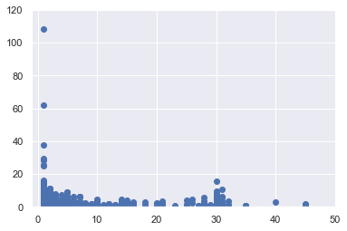
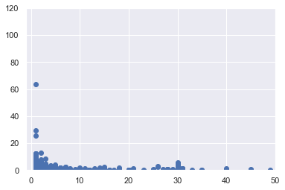


Activity vs Minimum Stay
Pre-Covid
Covid
Pre-Vaccine
Post-Vaccine

Slide 30




Activity vs Host Profile Picture
Pre-Covid
Covid
Pre-Vaccine
Post-Vaccine

Slide 31

London Activity Analysis

Slide 32




Activity vs Room Type
Pre-Covid
Covid
Pre-Vaccine
Post-Vaccine

Slide 33




Activity vs Price
Pre-Covid
Covid
Pre-Vaccine
Post-Vaccine

Slide 34




Activity vs Minimum Stay
Pre-Covid
Covid
Pre-Vaccine
Post-Vaccine

Slide 35




Activity vs Host Profile Picture
Pre-Covid
Covid
Pre-Vaccine
Post-Vaccine

Slide 36
Importance of features across time period for New York vs London
S.No | Features | Importance |  | Change in %
 |  | New York | London
1 | host_response_rate | -0.0025 | -0.0002 | 936.7%
2 | host_acceptance_rate | 0.0064 | 0.0049 | 31.7%
3 | host_is_superhost | 0.3405 | 0.3054 | 11.5%
4 | host_listings_count | -0.0023 | -0.0011 | 112.4%
5 | accommodates | 0.0444 | 0.0058 | 668.9%
6 | instant_bookable | 0.1850 | 0.3177 | -41.8%
7 | review_scores_rating | -1.1968 | -0.6450 | 85.6%
8 | review_scores_accuracy | 0.0786 | 0.2805 | -72.0%
9 | review_scores_cleanliness | 0.4255 | 0.1535 | 177.3%
10 | review_scores_checkin | 0.0685 | -0.1123 | -161.0%
11 | review_scores_communication | -0.1950 | 0.1334 | -246.1%
12 | review_scores_location | 0.1934 | 0.1578 | 22.6%
13 | review_scores_value | 0.7815 | 0.2292 | 240.9%
14 | minimum_nights | -0.0062 | -0.0041 | 49.1%
15 | maximum_nights | -0.0001 | 0.0000 | -277.2%
16 | Hotel room | 2.2268 | 0.4835 | 360.6%
17 | Private room | 0.1968 | 0.4376 | -55.0%
18 | Shared room | -0.2074 | 1.7626 | -111.8%

Slide 37
Recommendations
New York
London
London
Overall
Overall
Invest in clean, budget friendly hotel rooms
Invest in instant bookable shared rooms
Communication is key
Ensure hosts have profile pictures
Location drives positive sentiments while host drives negative ones

Slide 38
Future Steps
01
02
03
04
Urban vs Rural Activity
‘Negative’ Host Evaluation
How did Covid affect rural and urban Airbnb locations? And how did these locations differ?
What makes a host experience positive or negative? What can a host do to improve their ratings?
Higher Prices
Additional Model Tuning
What caused the demand for higher priced Airbnb stays?
Is regression the best model to use for this problem? Decision tree? Neural network?

Slide 39
Lessons Learned

Slide 40
Lessons Learned
01
02
03
04
Evolving Requirements
Resource Allocation
Agile is more accommodating to evolving requirements
Resources were not overworked as part of Agile
Cost Optimization and Faster Delivery
Accountability and Empowerment
Agile workflow wrapped up the project much earlier than the waterfall workflow thus saving on time and cost
Agile promoted task accountability and overall motivation and commitment to project outcomes

Slide 41

Q & A

Slide 42
Smartsheet Link
Project Mafia_baseline - Smartsheet.com

